Slide 1
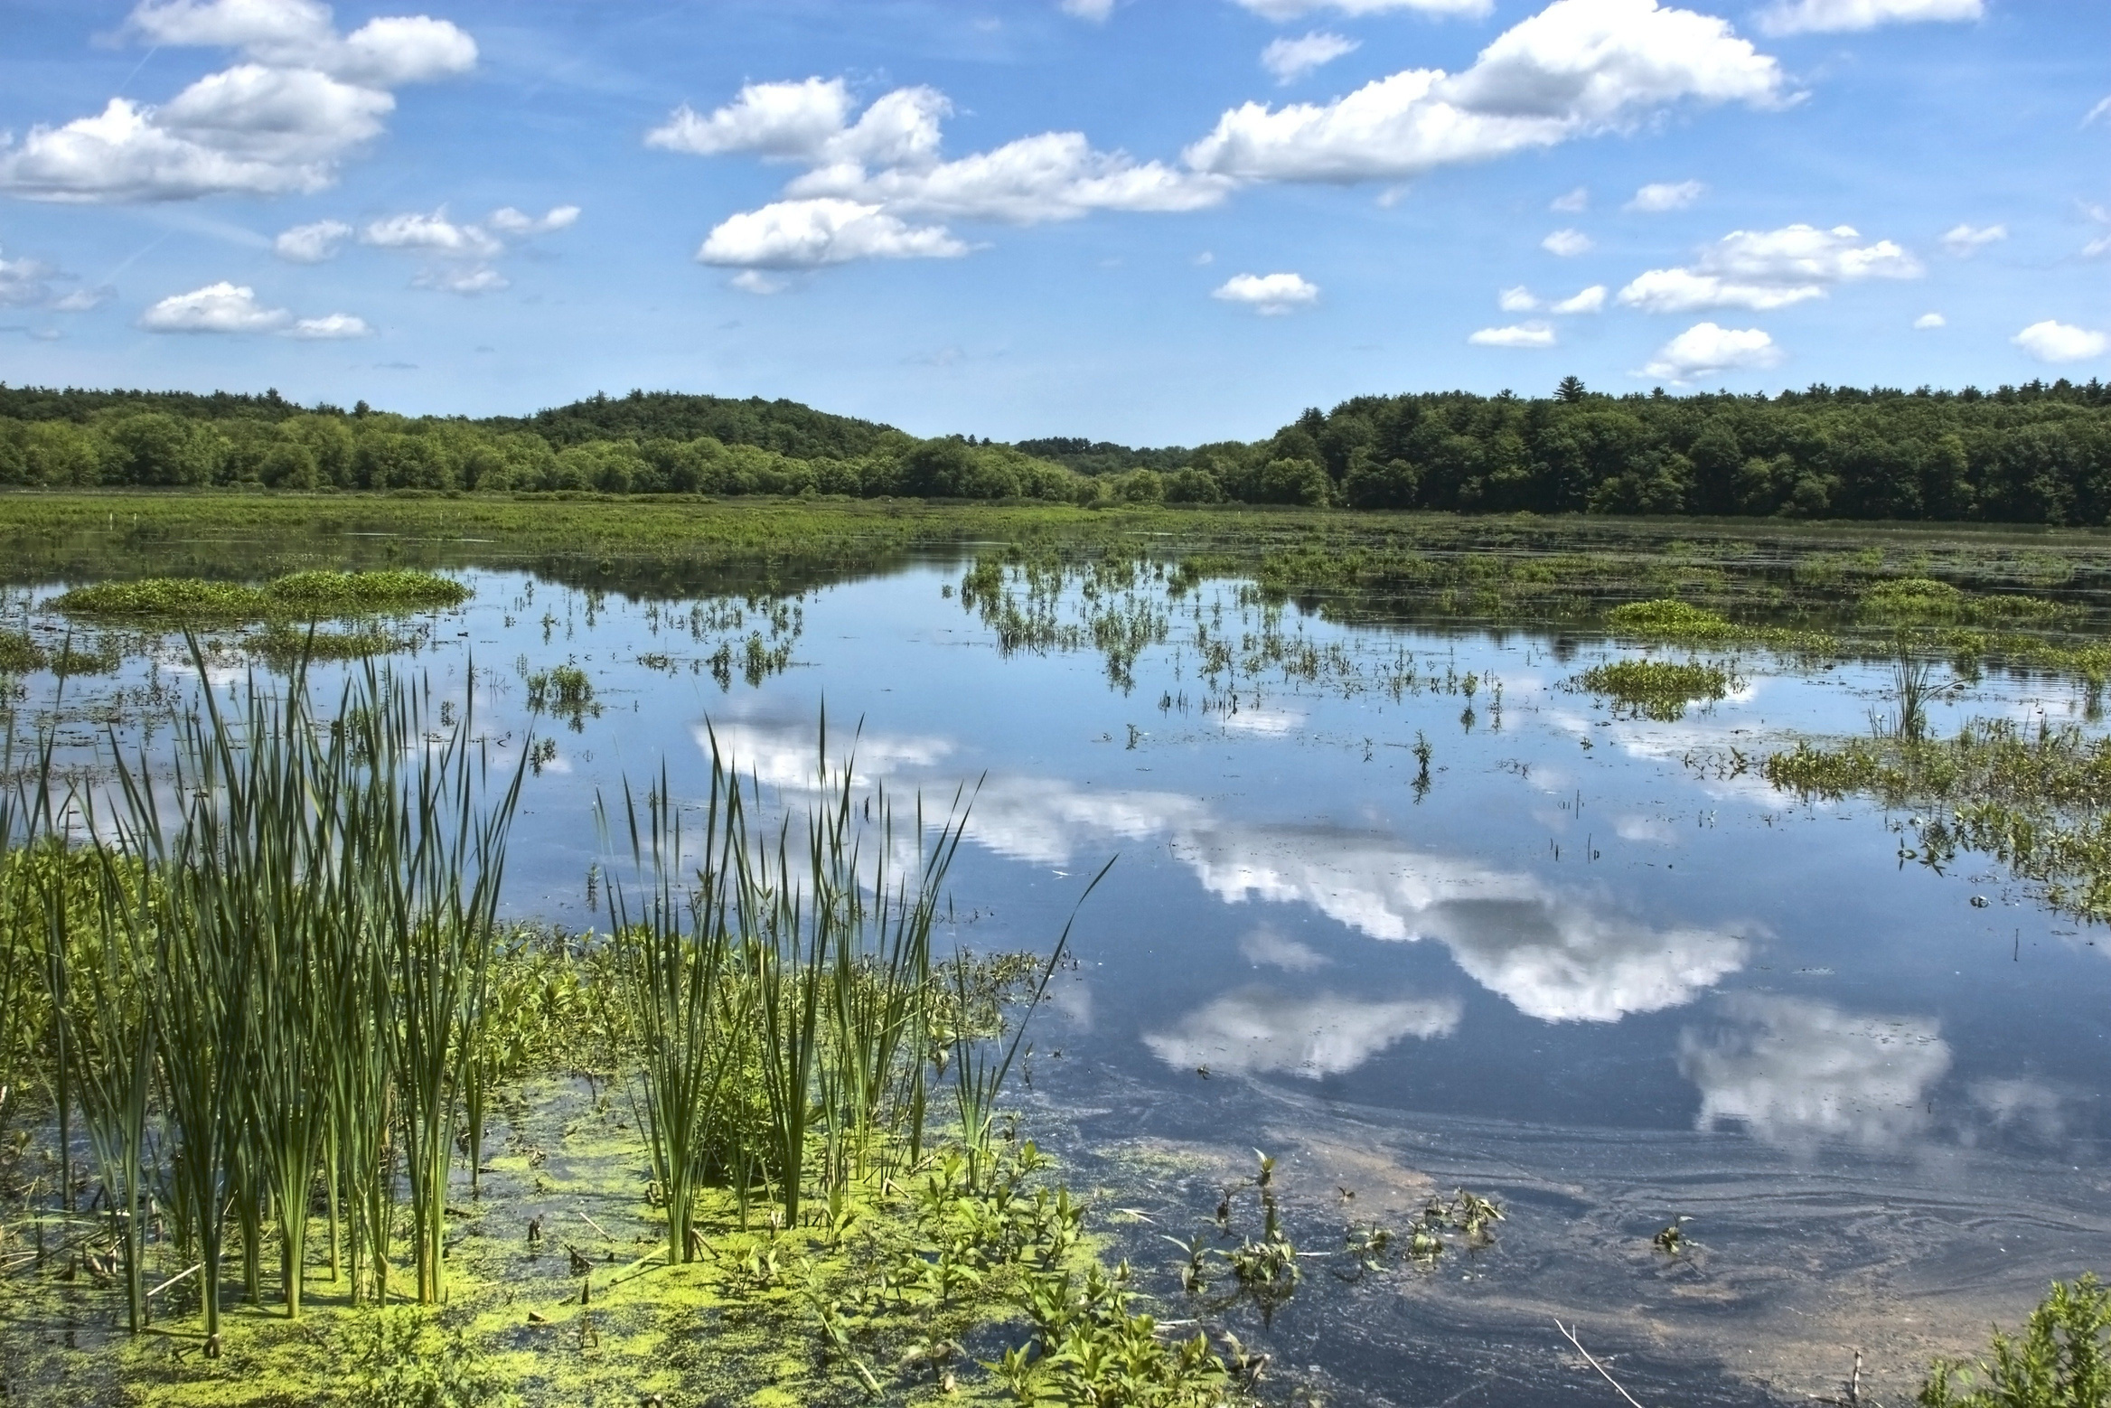



Land Cover and Area Influence Bird Biodiversity in Geographically Isolated Wetlands
Jackson Barratt Heitmann, Brittany M. Mason, and Corey T. Callaghan
Fort Lauderdale Research Center, University of Florida

Slide 2
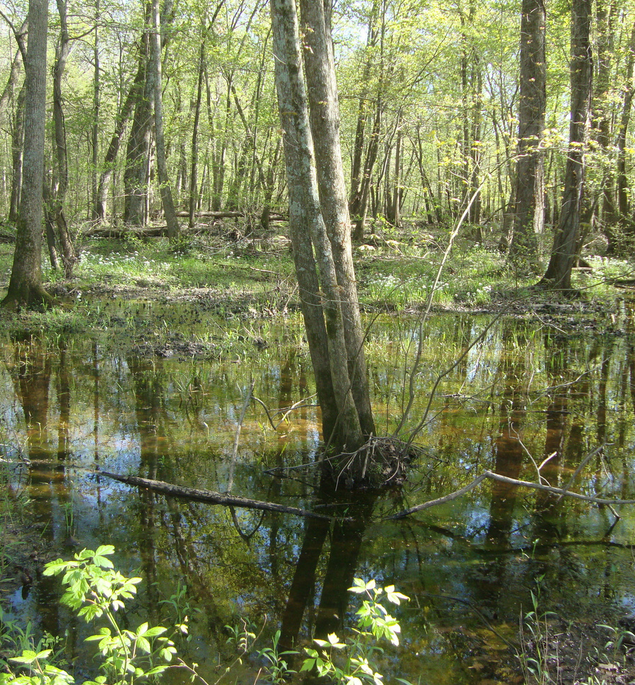
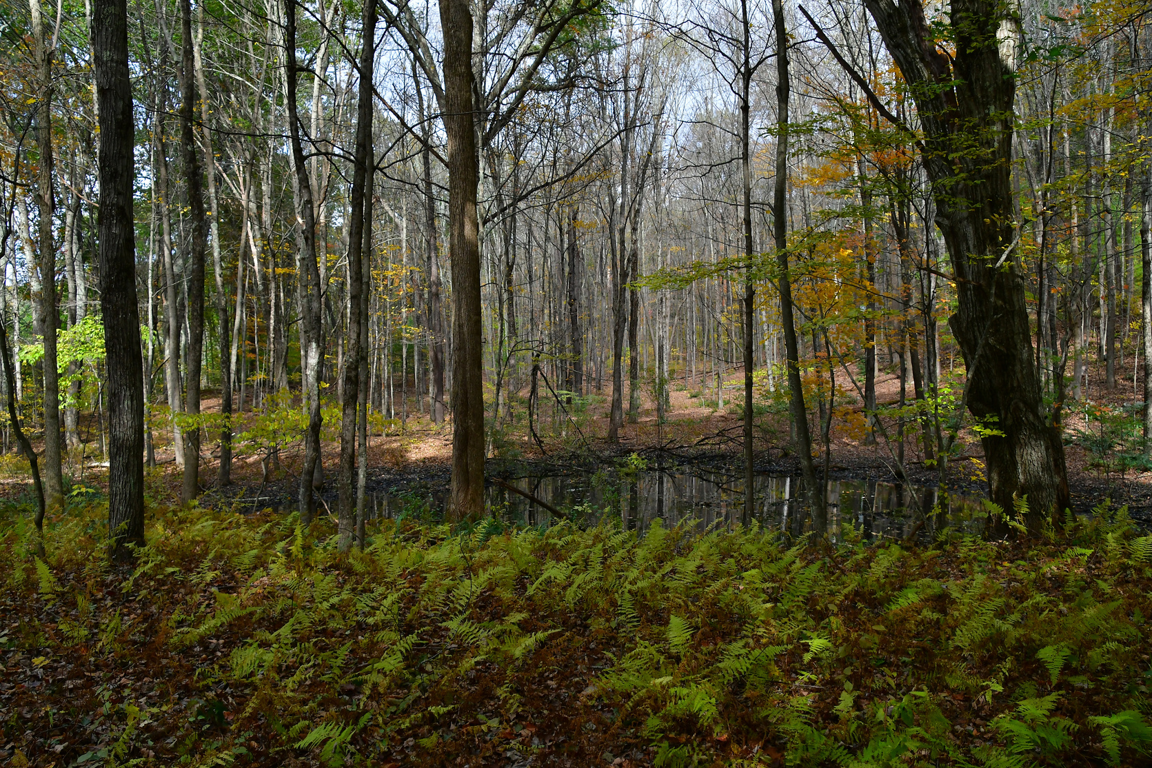
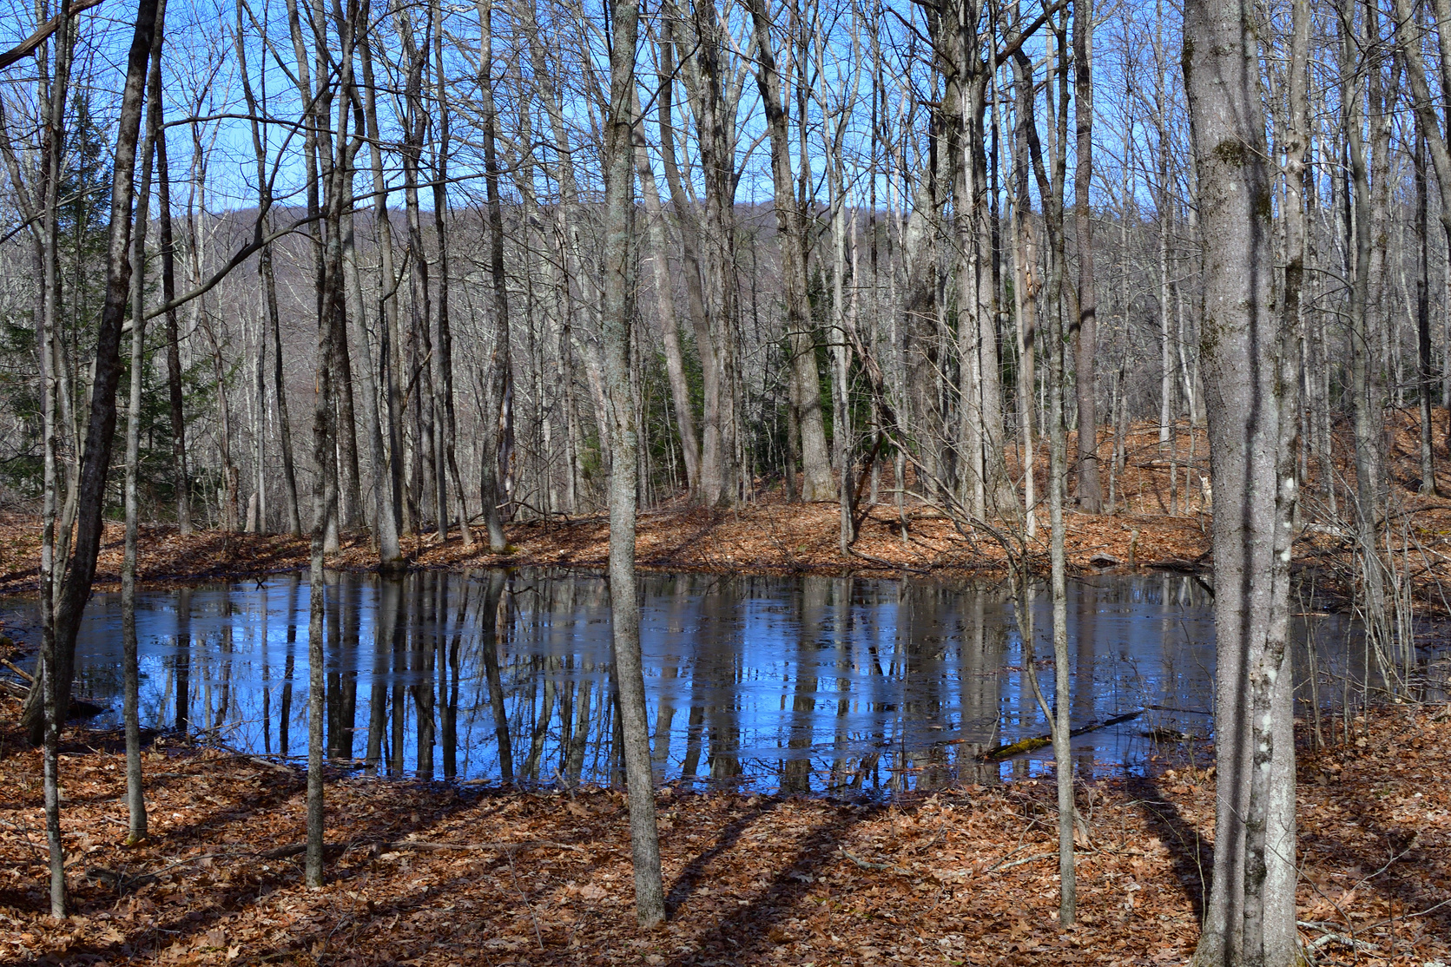
What are Geographically Isolated Wetlands?
Wetlands with no surface water connection (at least part of the year)
Characterized by: variable hydrology, vegetation, and area
2

Slide 3

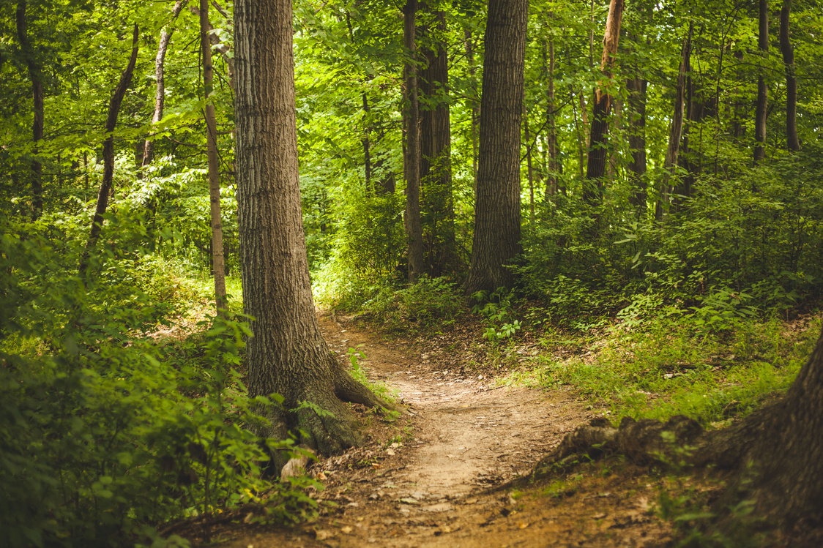
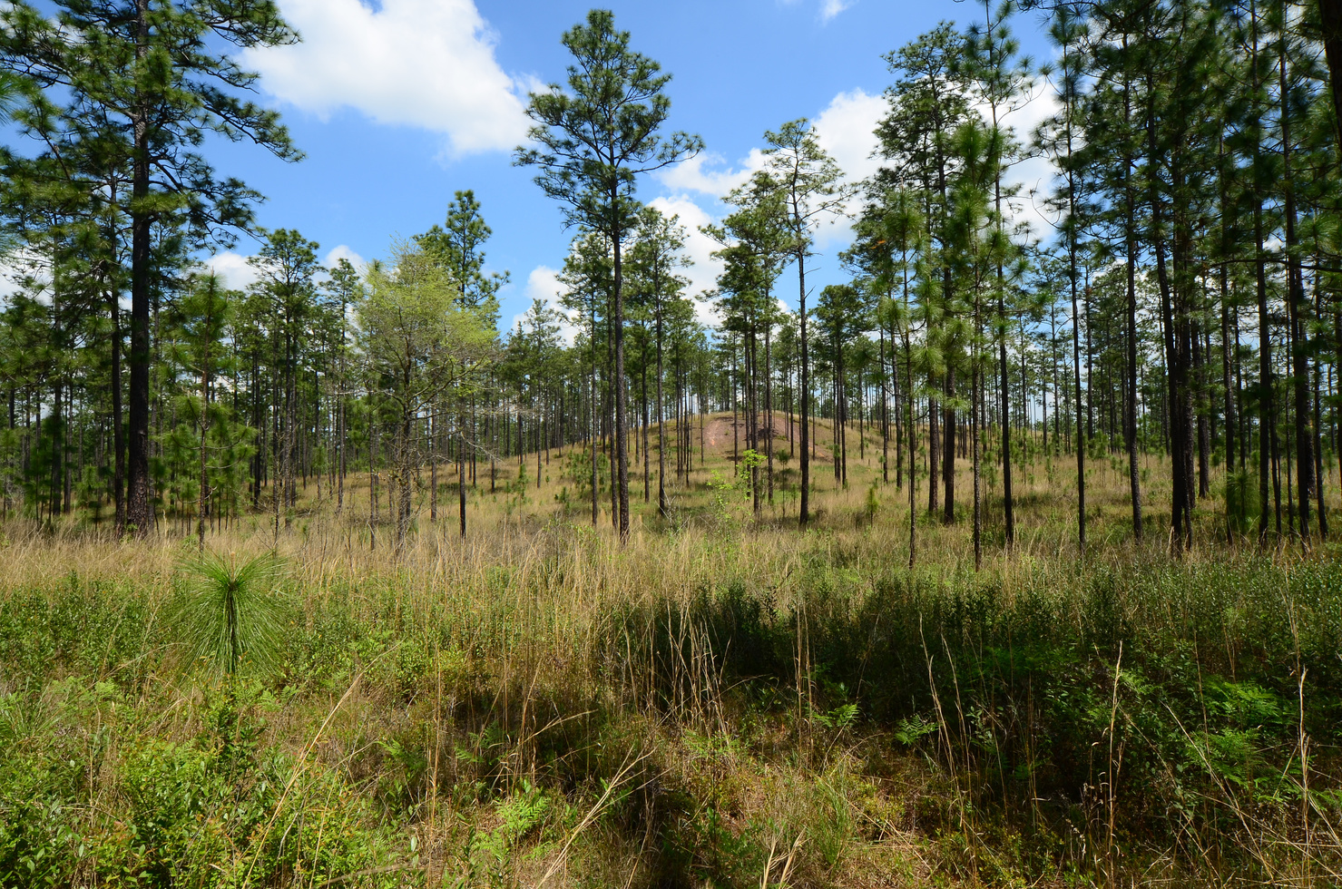
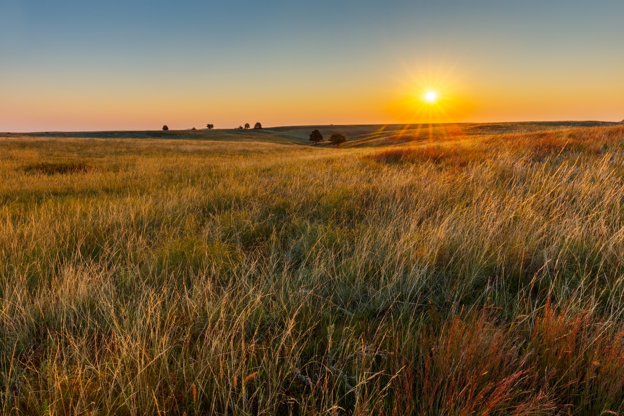
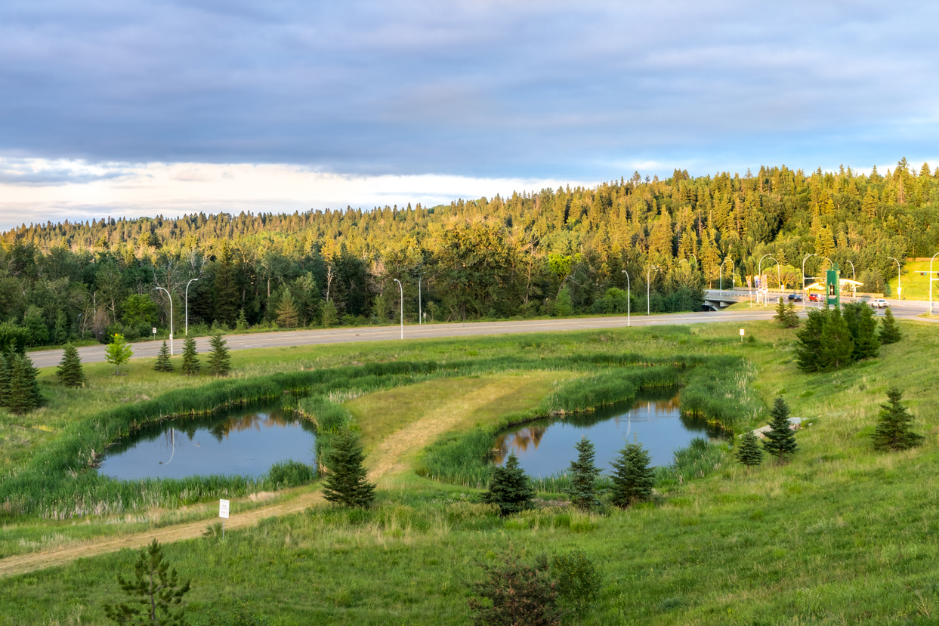
Where are they found?
Hardwood forest; Prairie; Pine Savanna; and Cities
Embedded in Habitat Mosaics, Across the U.S.
Continental Distribution, with Variety [ie. Carolina Bays, Prairie Potholes, Vernal Pools, etc.]

Slide 4
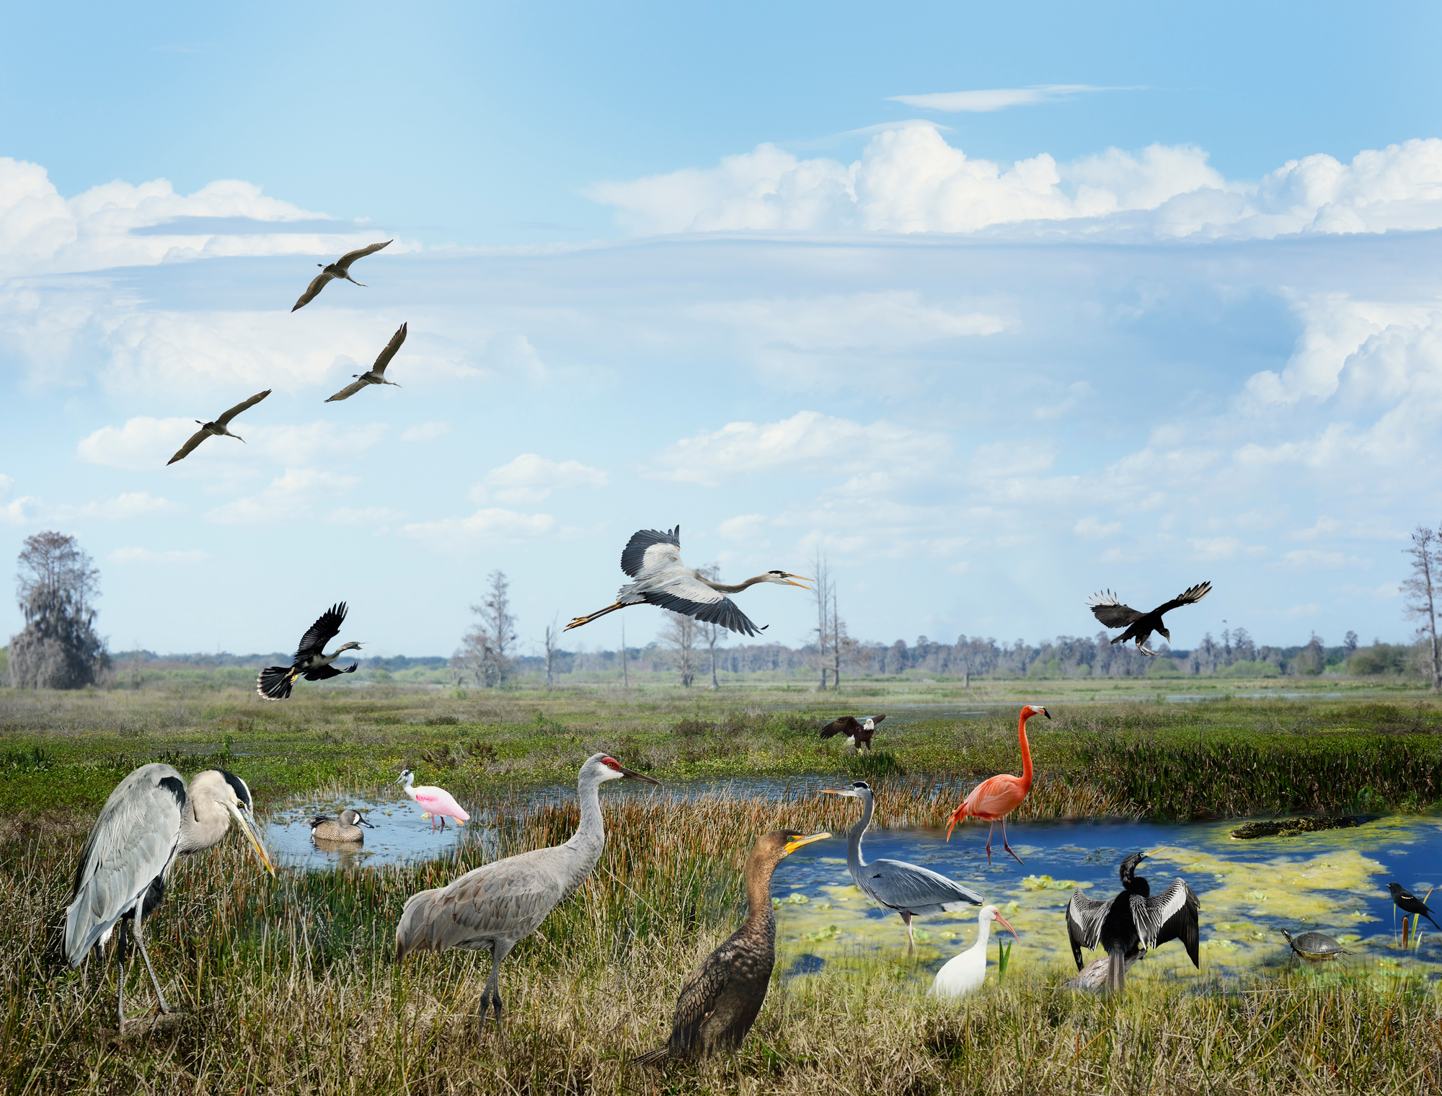
What do we know about Birds in Isolated Wetlands?
Evidence species richness is higher in wetlands than surrounding uplands.
*Barratt Heitmann et al. 2024, Riffel et al. 2006
Species richness is higher in urban wetlands compared to rural ones.
(McKinney and Paton 2009)
But, we don’t know how these affect different functional groups of birds...

Slide 5
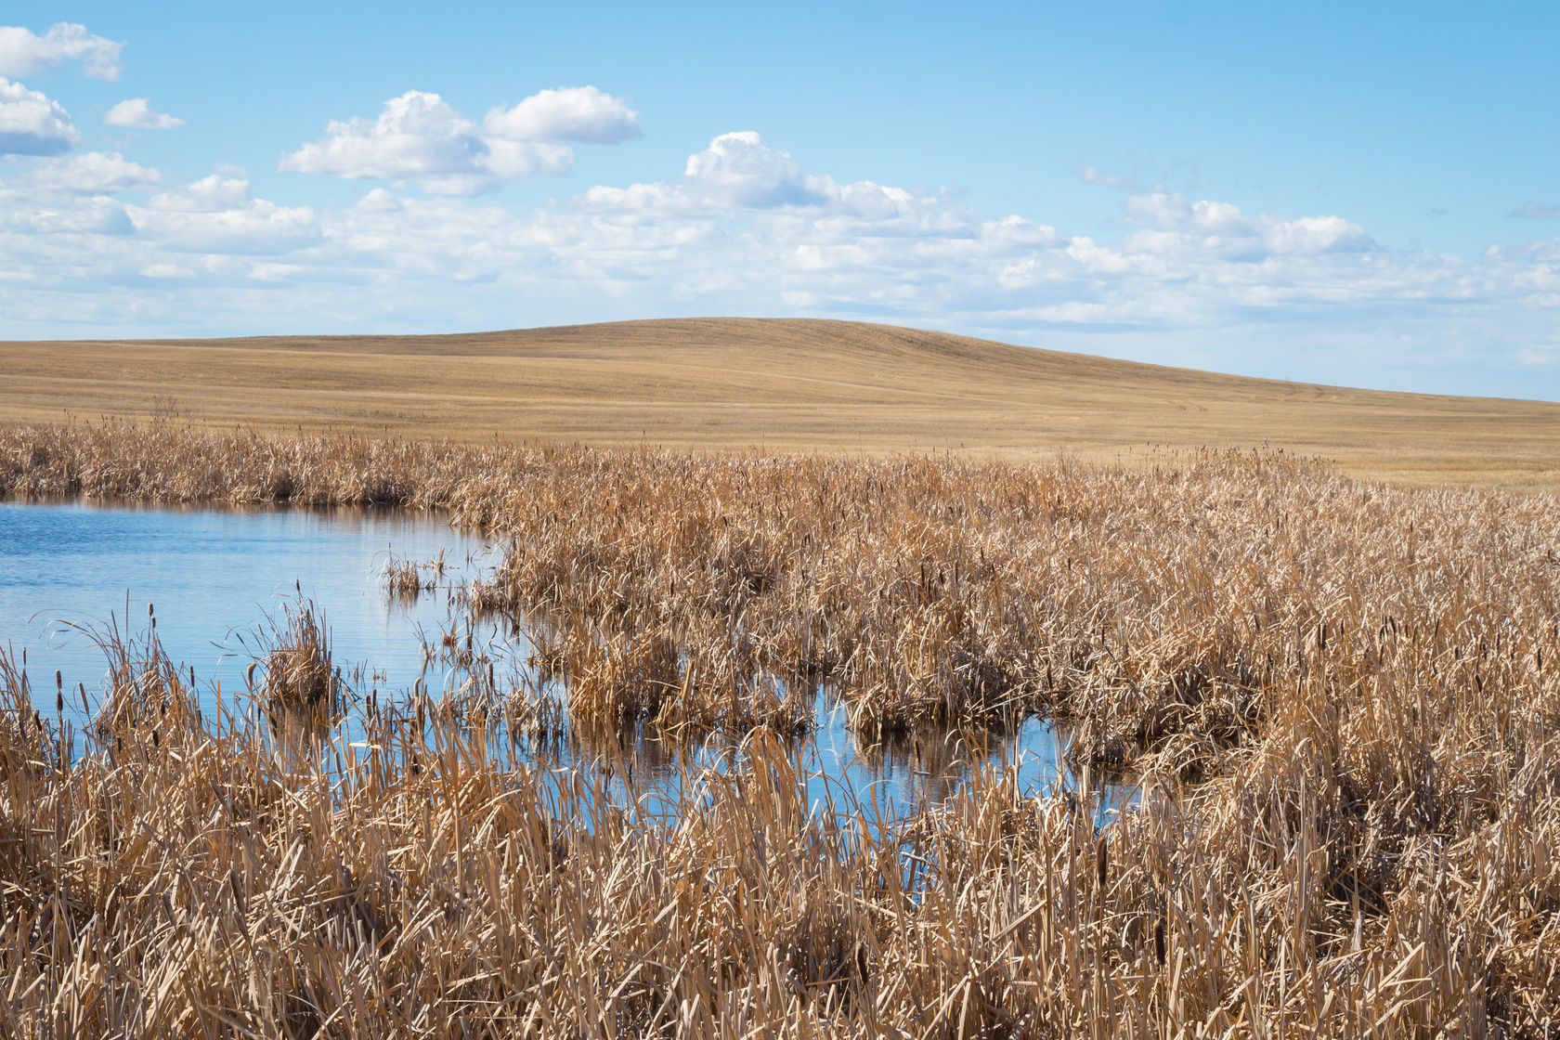



How does land cover impact birds in these wetlands?
Higher wetland area at the landscape scale (>3 km) supports higher bird biodiversity.
(Webb et al. 2010)
Higher flooded vegetation land cover supports higher bird biodiversity.
(Fairbairn and Dinsmore 2001)

Slide 6
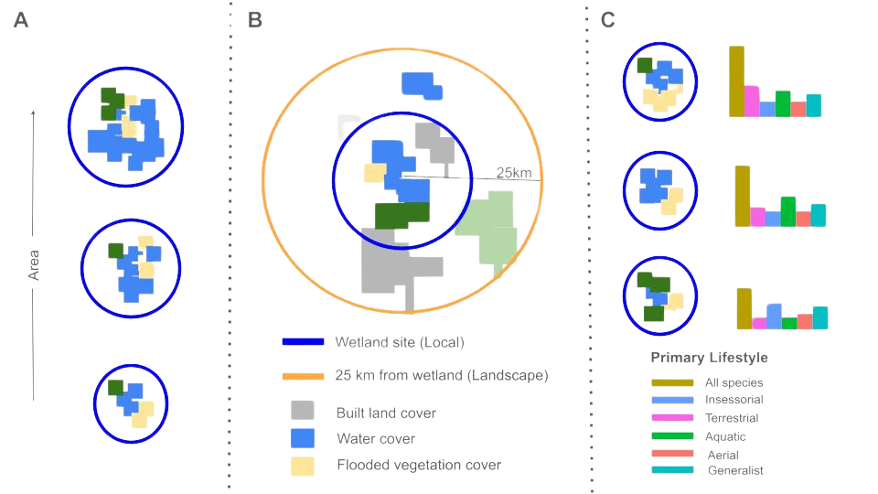
The research gaps we aim to fill:

Slide 7
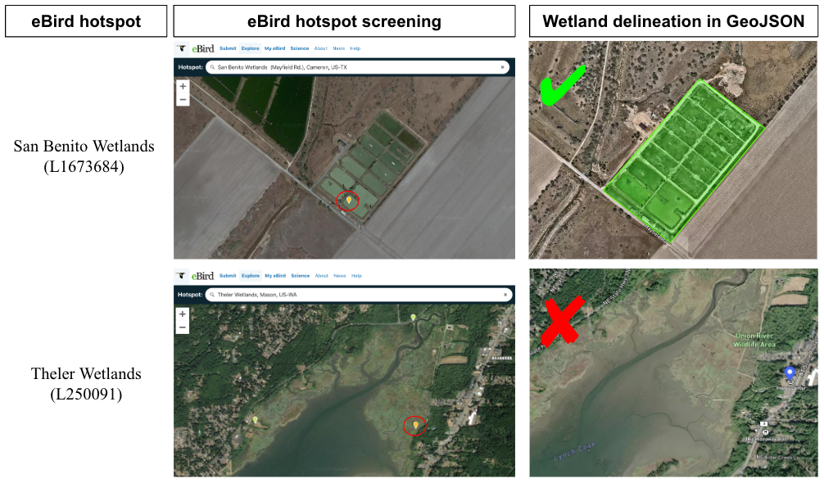
Integrating 207 wetlands with eBird hotspots across the conterminous United States

Slide 8
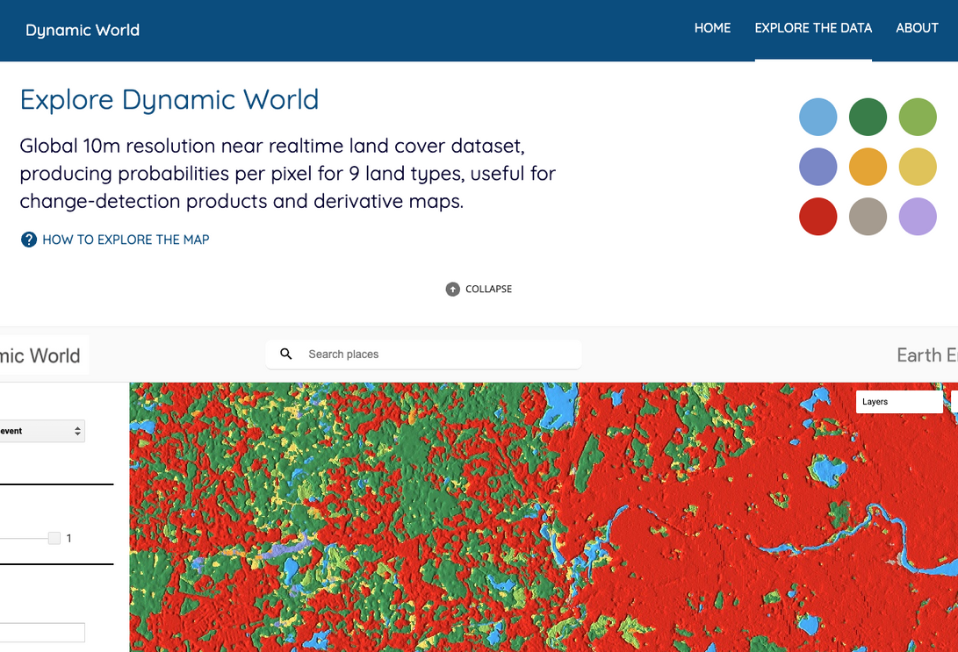


Gathering land cover data from Google Earth Engine, and calculating species richness from eBird.
eBird Hotspot ID
Species Richness
Land Cover
Calculating overall species richness at each eBird hotspot, as well as species richness of 5 different functional groups (Tobias et al. 2022).
Generalized Linear Model (6 of them)

Slide 9
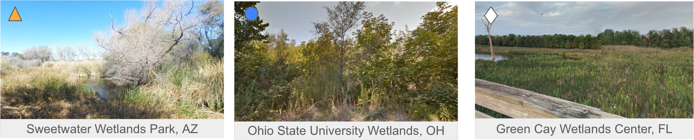
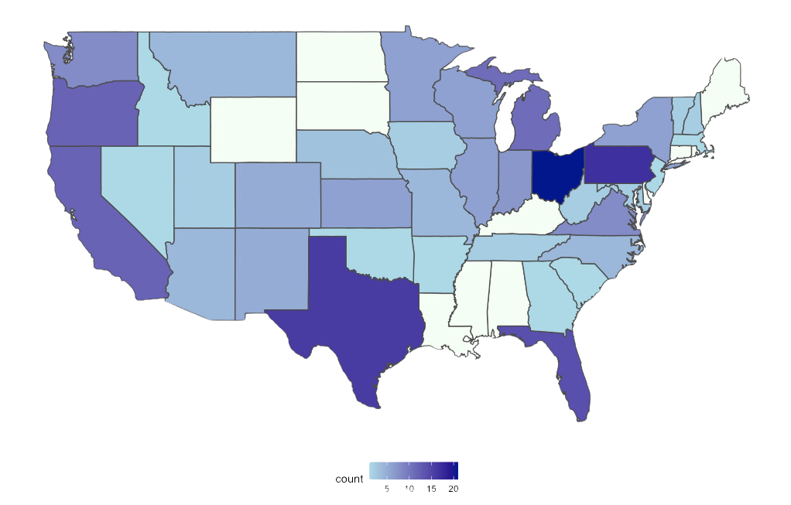


Slide 10
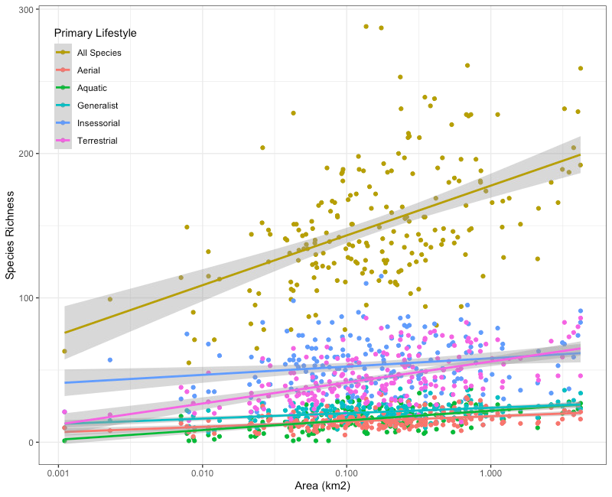
Objective 1: Species Richness Increases with Wetland Area
We found that species richness increases as wetland area increases.
This was most pronounced for Terrestrial and aquatic primary lifestyles.

Slide 11
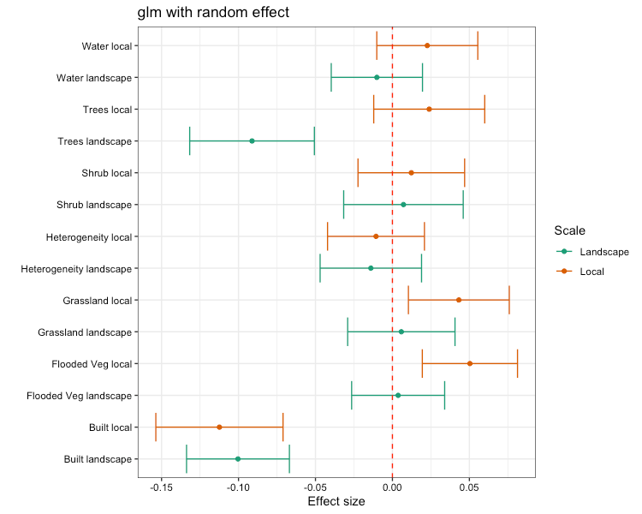
Objective 2: Built area reduces species richness, flooded vegetation increases species richness.
Built land area reduces richness at multiple scales.
Trees reduced species richness, likely due to environmental filtering in the Temperate Forests of the Northeast.
Flooded vegetation and grass cover promote richness at the local scale.

Slide 12
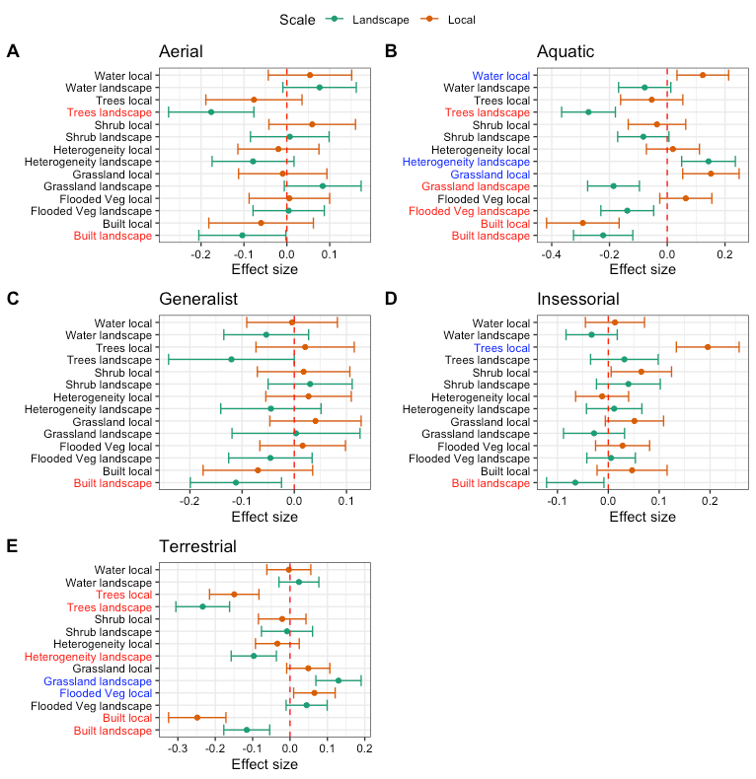
Objective 3: Land cover impacts functional group richness differently
All species respond negatively to built land area, at multiple scales.
Aquatic species richness.

Slide 13
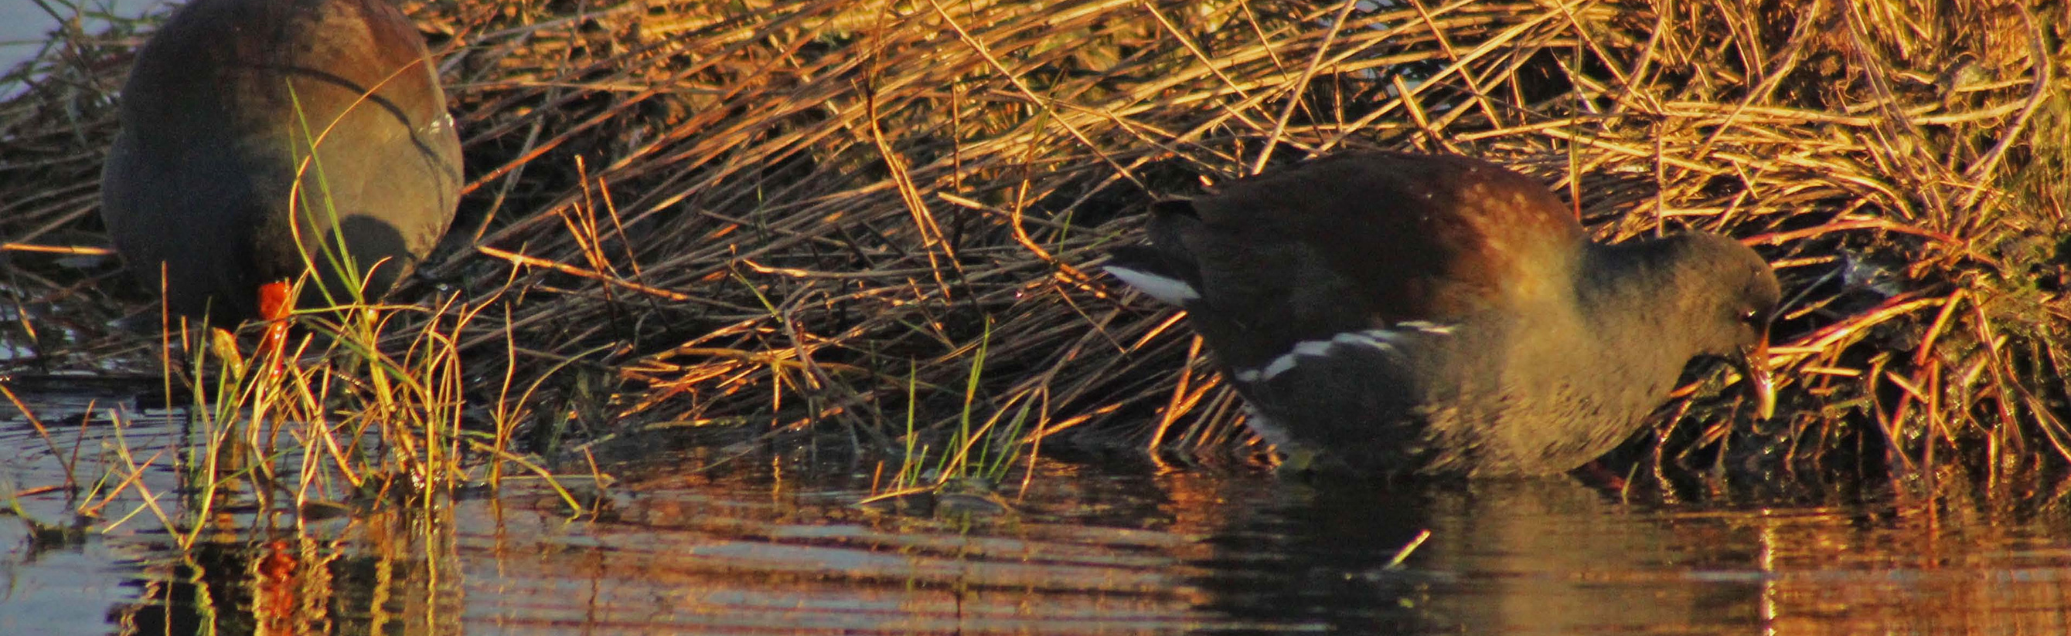


What does this mean for birds in GIWs?
Terrestrial and aquatic species richness drive the species area realtionship in GIWs, likely due to larger wetlands being visited by a greater number of larger-bodied species compared to relatively smaller insessorial and aerial species.
Landscape variables are responsible for negative trends in richness, local variables responsible for positive predictors of species richness.

Slide 14
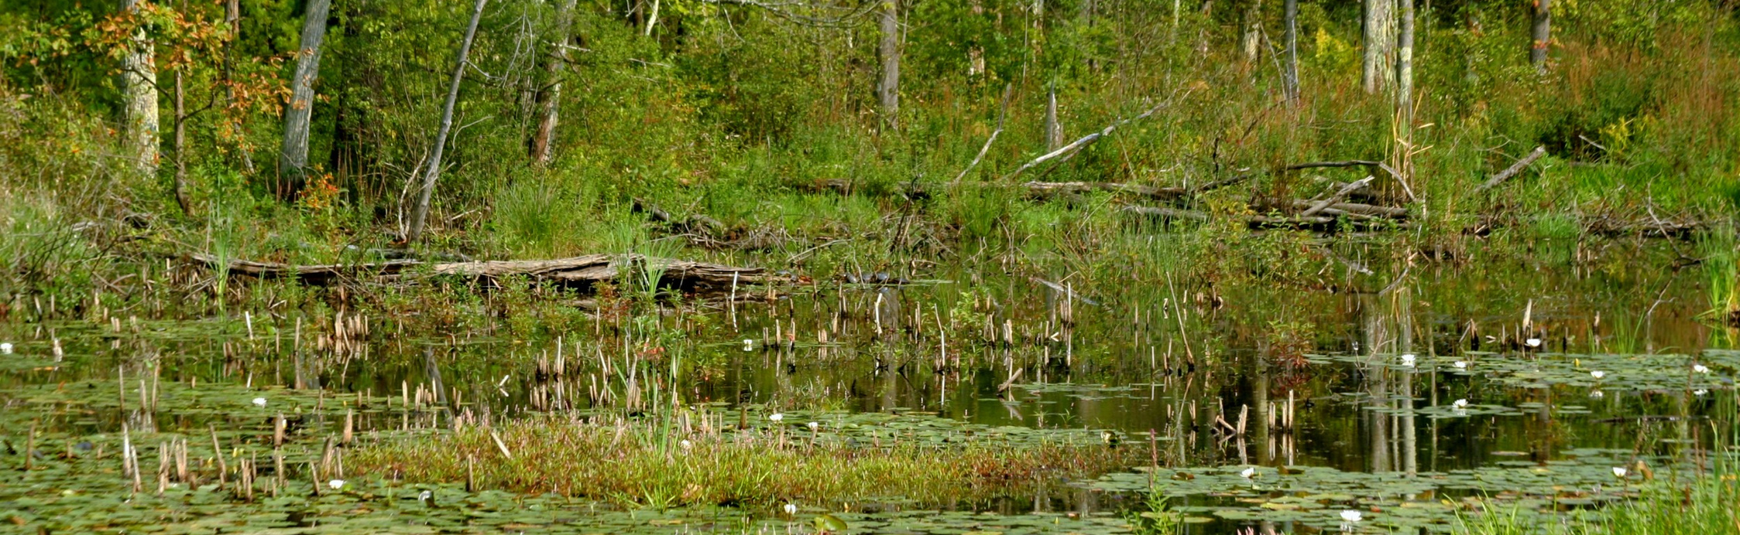
What can managers and restoration ecologists do with this information?
Prioritizing preservation/restoration/creation of larger wetlands
incorporating flooded vegetation in stormwater ponds, restoration of natrual wetlands, and created wetlands

Slide 15
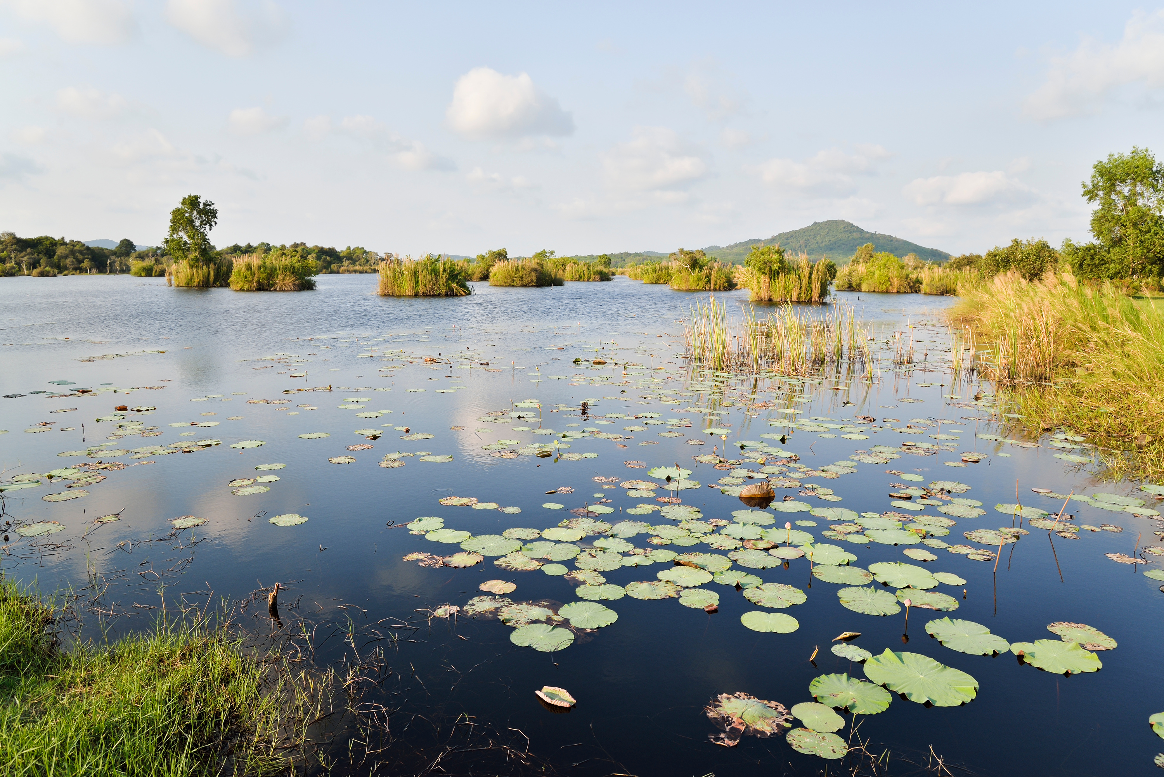

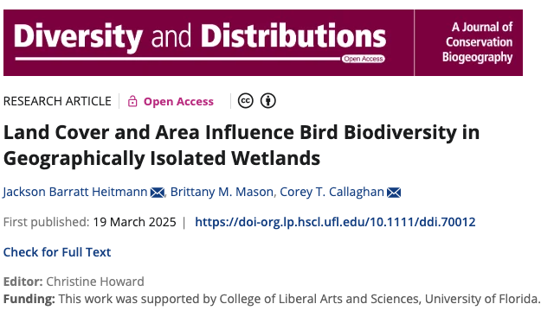




Thanks to everyone who contributes to eBird.
Don’t forget to go birding at small isolated wetlands!

